Slide 1
Katowice, 08.10.2016

Slide 2
https://goo.gl/Kfz8RH
Podróże w czasie z SQL Server 2016 dla każdego
Damian Widera
damian.widera@euvic.pl

Slide 3


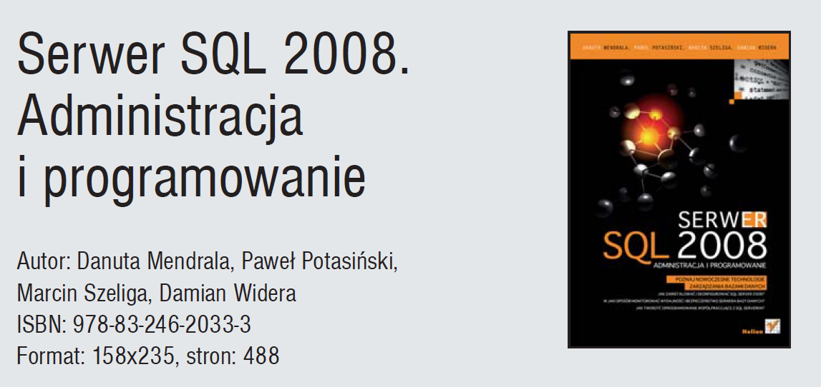
Damian Widera
damian.widera@euvic.pl
@Damian.Widera
http://sqlblog.com/blogs/damian_widera/default.aspx

Slide 4





CZŁONKOWIE GRUPY

Slide 5









WYBRANI KLIENCI

Slide 6
https://goo.gl/Kfz8RH
Podróże w czasie z SQL Server 2016 dla każdego
Damian Widera
damian.widera@euvic.pl

Slide 7

Today I am going to tell about….
Time travelling – how to make it possible with SQL Server 2016
  At least in terms of data not actual time journey

Slide 8
A little bit of the history
How you monitor data changes now?
    Triggers
    Stored procedures
    Change Data Capture (CDC)
    Change Tracking (CT)
How to do it with Temporal Tables
    Scenarios
    How it works?
    Developers ….
    Performance ….

Slide 9
Triggers
All SQL Server versions & editions
Easy to implement - INSERT, UPDATE, DELETE
But – changing the source table definition almost always require to change the code of the trigger
Interact with other triggers – @@IDENTITY
Transactional

Slide 10
Stored procedures
All SQL Server versions & editions
Could be easy to implement
Changing the source table structure possibly require the change in the procedure
Called from the applications

Slide 11
Change tracking
Tracks changes on DML operations like INSERT, UPDATE and DELETE
Only last version of data
  No historical changes
  How many times a record has changed?
A table can have only one CT related
table

Slide 12
Change Data Capture
Tracks changes on DML operations like INSERT, UPDATE and DELETE
All changes are stored
  Full changes history
A table can have up to two CDC related tables

Slide 13
SQL Server 2016
Mission-critical performance
Deeper insights across data
Hyperscale cloud

Slide 14
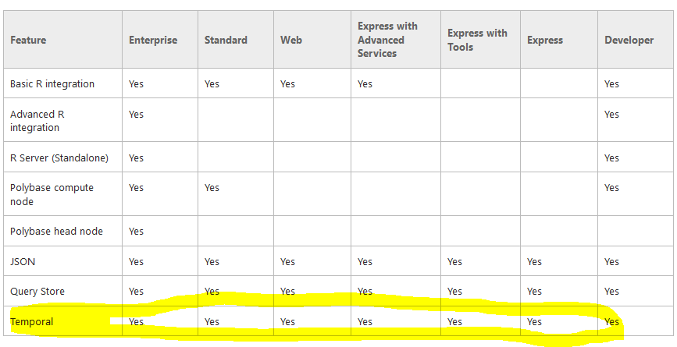
Temporal tables

Slide 15
Why temporal
Data changes over time
Tracking and analyzing changes is often important
Temporal in DB
Automatically tracks history of data changes
Enables easy querying of historical data states
Advantages over workarounds
Simplifies app development and maintenance
Efficiently handles complex logic in DB engine
Time travel
Data audit
Slowly changing dimensions
Repair record-level corruptions
Performance

Slide 16
How to start - remarks
Primary key must be present on the base table
Turn on the SYSTEM_VERSIONING option on a table to make it temporal
Add two non-nullable columns of type DATETIME2() that represents the start and the end od period when the row is valid
  A column that represents the start of the period must be marked as GENERATED ALWAYS AS ROW START
  A column that represents the end of the period must be marked as GENERATED ALWAYS AS ROW END

Slide 17
How to start – remarks - cont.
Add a statement at the table level for setting up the per: PERIOD FOR SYSTEM_TIME (<startcol>, <endcol>)
The historical table can be created:
  By the SQL Server
  By the user
In both cases the historical table will be PAGE compressed

Slide 18
How to start – remarks - cont.
The base table can be partitioned
  The partition schema & function will not be moved to the historical table
Both base table and the historical table must be in the same database
The historical table cannot have PK, FK or any other constraints
Indexed views are not supported

Slide 19
How to start – remarks - cont.
The DML operations cannot affect the columns that store the period information
  True if the SYSTEM_VERSIONING is turned on
TRUNCATE TABLE will not work with the SYSTEM_VERSIONING option turned on
The DML cannot be done on the historical table
DBCC CHECKCONSTRAINTS works little bit different
https://msdn.microsoft.com/en-us/library/ms189496.aspx

Slide 20
How to start with temporal
ANSI 2011
compliant
No change in programming model
New Insights
  CREATE temporal TABLE PERIOD FOR SYSTEM_TIME…
  ALTER regular_table TABLE ADD PERIOD…
DML
Temporal Querying
  SELECT * FROM temporal
  FOR SYSTEM_TIME
    AS OF
    FROM..TO
    BETWEEN..AND
    CONTAINED IN
  INSERT / BULK INSERT
  UPDATE
  DELETE
  MERGE
DDL
Querying
Performance

Slide 21

How the AS OF works – historical data
Department (actual data)
DepNum | DepName | MngrID | From | To
A001 | Marketing | 6 | 2008 | ∞
A002 | Sales | 5 | 2007 | ∞
AS OF
“Get actual row versions”
BETWEEN..AND
Department (actual and historical data)
CONTAINED IN
DepNum | DepName | MngrID
A001 | Marketing | 5
A001 | Marketing | 6
A002 | Sales | 2
A002 | Sales | 5
A003 | Consulting | 6
A003 | Consulting | 10
Department (historical data)
A001
DepNum | DepName | MngrID | From | To
A001 | Marketing | 5 | 2005 | 2008
A002 | Sales | 2 | 2005 | 2007
A003 | Consulting | 6 | 2005 | 2006
A003 | Consulting | 10 | 2009 | 2012
A001
∞
A002
∞
A002
A003
A003
2005
2015
SELECT * FROM Department FOR SYSTEM_TIME
CONTAINED IN ('2007.01.01', '2009.01.01')
SELECT * FROM Department FOR SYSTEM_TIME
AS OF '2006.01.01'
SELECT * FROM Department FOR SYSTEM_TIME
BETWEEN '2006.01.01' AND '2007.01.01'
„Now”
Valid data
SELECT * FROM Department

Slide 22

How does system-time work?
Temporal table (actual data)
History table
* Old versions
Update */ Delete *
Insert / Bulk Insert

Slide 23
How does system-time work?
Temporal table (actual data)
History table
* Include historical version
Regular queries
(current data)
Temporal queries *
(Time travel, etc.)

Slide 24




Temporal data continuum
SQL Database
Temporal
queries

Slide 25
Wrocław, 18.06.2016

